Slide 1
Private and Protected Are Just Suggestions
When Umbraco says no – just do it anyway

Slide 2

About Me
Kaspar Boel Kjeldsen
Senior Developer @ Kraftvaerk (since 1st of May)
Package Developer
Umbraco CMS Advisory Board Member
Unofficially titled ”Minister of Dangerous Code”
Starting up and leadning an Umbraco Competency Group (The Umbraco Guild) in Kraftvaerk
Father of 2, husband of 1, decider of 0
Github: kasparboelkjeldsen

Slide 3

UMBRACO
Why we are here
Update app setting
Doing stuff we are not supposed to is fun
Sometimes useful
Sometimes even necessary
I have a title to maintain
Implement interface
Replace Umbraco Implementation
´Code Patching
Fork

Slide 4
HarmonyLib

Slide 5




What is HarmonyLib?
HarmonyLib is a .NET library for runtime method patching — think of it as "modding" C# code while it's running.
It lets you prefix, postfix, or rewrite any method, even private or internal ones — no source code required.
https://github.com/pardeike/Harmony

Slide 6

How can we use it?
In order of best idea to worst idea
Inject your own code before a method runs
Inject your own code after a method has run
Replace the entire method with your own
Transpile a method, literally replacing code-operations at runtime.

Slide 7
DEMO TIME

Slide 8
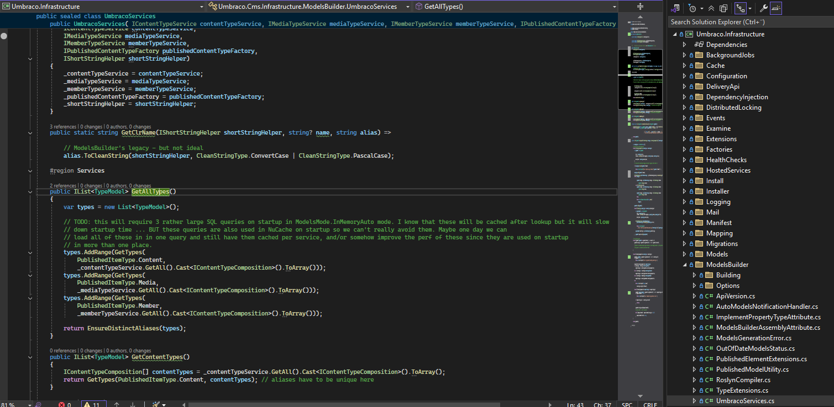
Our first target: Do something sorta useful with the modelsbuilder

Slide 9
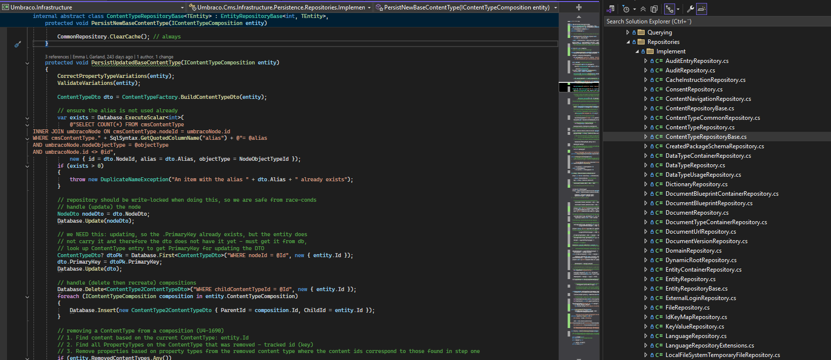
Our second target: Make absolutely sure every document type description starts with a a 🍌

Slide 10
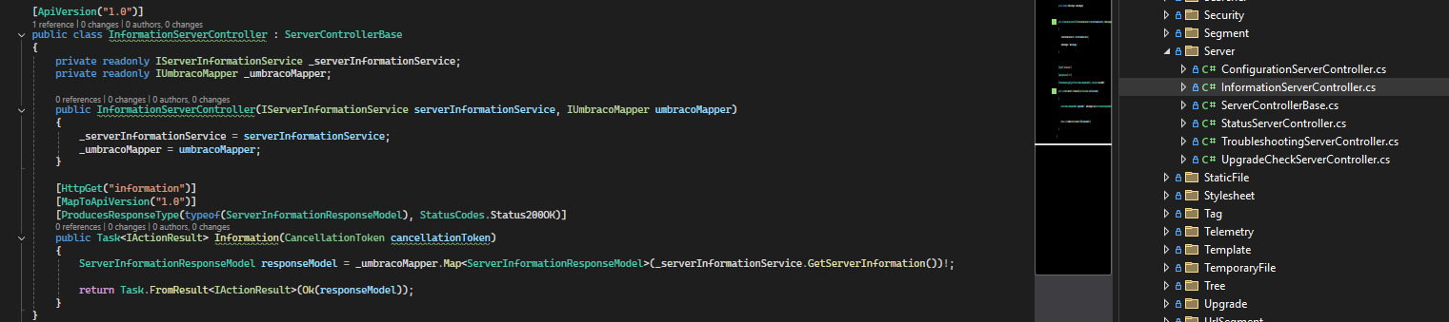
Our final target: Transpile some code between responseModel and the Ok()

Slide 11
When have I used it?
That time Umbraco made ”PostSaveBlueprint” only accessible to users with Settings access.
(version 8.18.12)
Umbraco introduced stricter security that broke DocType Grid Editor, allowing only users with Settings access to create or edit DTGE blocks. The increased API restrictions would have forced me to make all my editors admins — which defeats the purpose of role-based access.
When I got tired of NuCache being locked on bootup from a distributed Umbraco solution
(version 13.x)
There is no inherent reason why we should fail catastrophically just because ”nucache.content.db” is locked. Umbraco is perfectly capable of making a new one and calling it nucache.content.<someguid>.db and using at, provided you show it how. (by completly hijacking the MainDomRegister method)
When we ran out of pageviews in Umbraco Engage the evening before a huge workshop with the customer
Don’t panic. Umbraco HQ was at the workshop too, it was only on a staging environment and I did confess.
But also, don’t do it.

Slide 12
When should you use it?
Probably never. But if Umbraco changes something that makes a project impossible to run safely, it can’t make it worse, can it?
Probably safe to use if you postfix/prefix/replace something that won’t get updated Ie. NuCache in v13 feels sorta safe almost.
Probably safe to use if you post/prefix something adding no side-effects (ie. I just ALSO want to do this seperate thing when Umbraco does it’s thing)

Slide 13


Thank you
Code and slides

